Slide 1
Finding Bugs: How to Write a Fuzzer

Slide 2
What’s a Bug?
A mistake in code
Allows for unintended functionality

Slide 3
Why Bugs Matter
Give attacker program control
Attack Software
Make Software

Slide 4

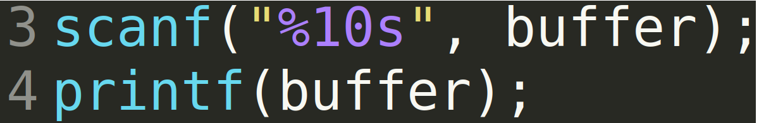
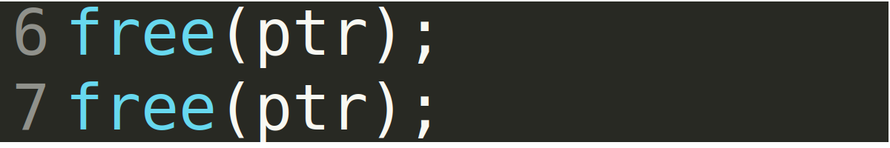

Slide 5
What does a fuzzer do?
Finds bugs
Spams inputs
Waits for crash

Slide 6
Code Path
A branch of code
Can be controlled with conditional

Slide 7
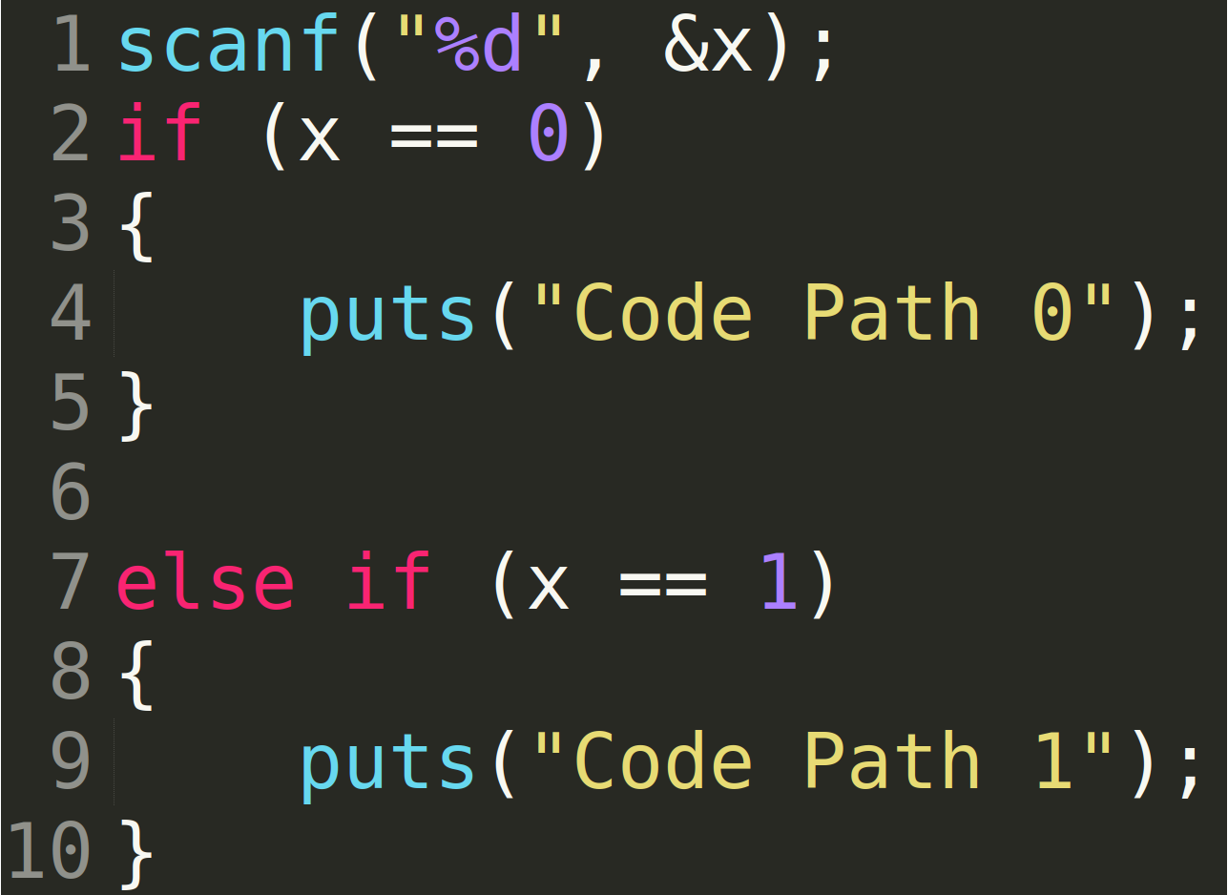

Slide 8
Most Important Thing
Send valid data
Interact like valid client

Slide 9
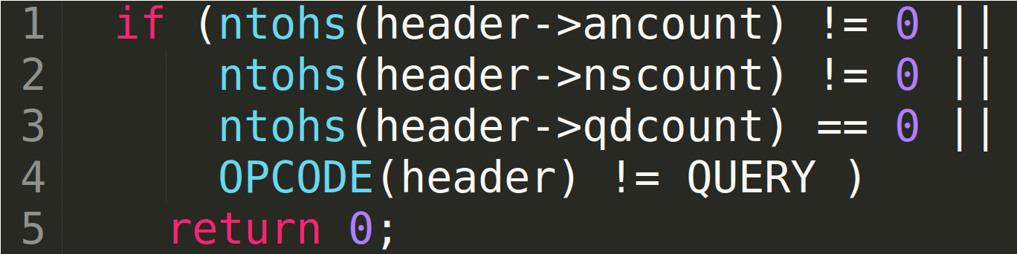
Most Important Thing

Slide 10
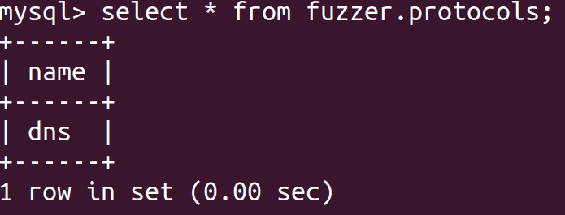
Session Based

Slide 11
Corrupters

Slide 12
Corrupting Data
Buffer Overflow
Insert Large String
Format String
Insert Format Strings like “%n”

Slide 13
Corrupting Data
Signed / Unsigned Integer Bugs
Insert really large / small integers
Flipping Bits
Helpful when dealing with single byte values

Slide 14
Corrupting Data
Parsing errors
Insert delimiters
Insert multiple copies
Leave it out

Slide 15
Corrupting Data
Corrupt just one thing
Most of the time
Other 5% of the time go wild

Slide 16
Crash Detection and Replay

Slide 17
Crash Detection
Monitor pid
Send null signal (signal 0)
TCP Handshake
Try to establish TCP connection
Monitor output
Not reliable

Slide 18
Seeds
Random function uses seed
Sequence based on seed
Same seed same sequence

Slide 19
Crash Replay
New seed for each fuzzing iteration
Dump seeds upon crash
Same seeds same behavior

Slide 20
Fuzzer Validation

Slide 21
Does the fuzzer work?
Bugs Found
Code Coverage
How many code paths is it missing?

Slide 22
Finding Bugs
Can it find N - Days?
https://www.exploit-db.com/
Can it pwn easy-ish targets?
https://github.com/

Slide 23
Finding Bugs
How many?
Common targets 5-10
Less common, it depends

Slide 24
Code Coverage
How much are you hitting?
How much are you missing?

Slide 25
Code Coverage
Non-Target Specific
80-95%
Target-Specific
90-100%

Slide 26
gcov
Built into gcc
Compile it with gcov
Source code required

Slide 27
gcov
Compile
Run

Slide 28
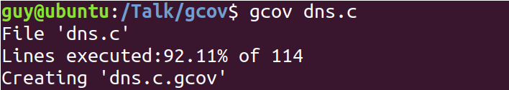
gcov
Check Coverage

Slide 29
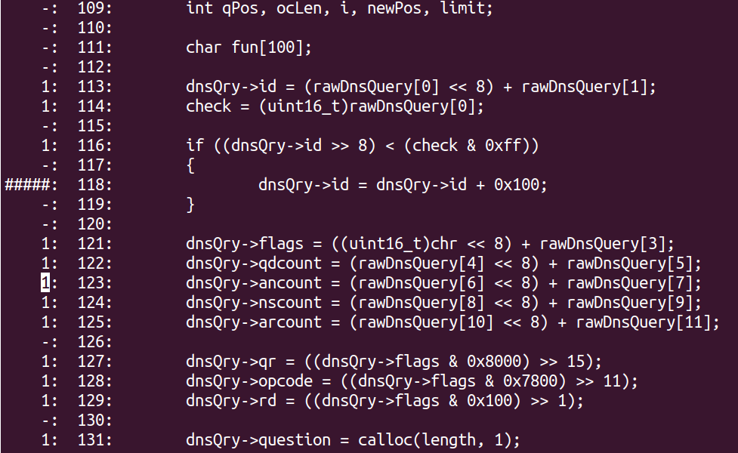

Slide 30
lighthouse
Markus Gaasedelen
https://github.com/gaasedelen/lighthouse/tree/master/coverage/pin
Uses Intel Pin
Framework for creation of binary analysis tools
Plugin to Binja/IDA
No Source Code needed

Slide 31
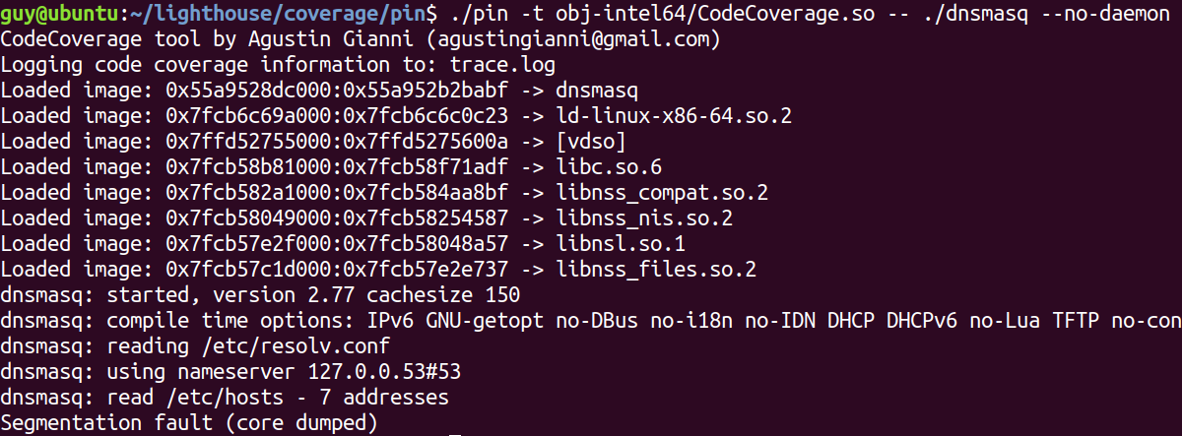
lighthouse

Slide 32
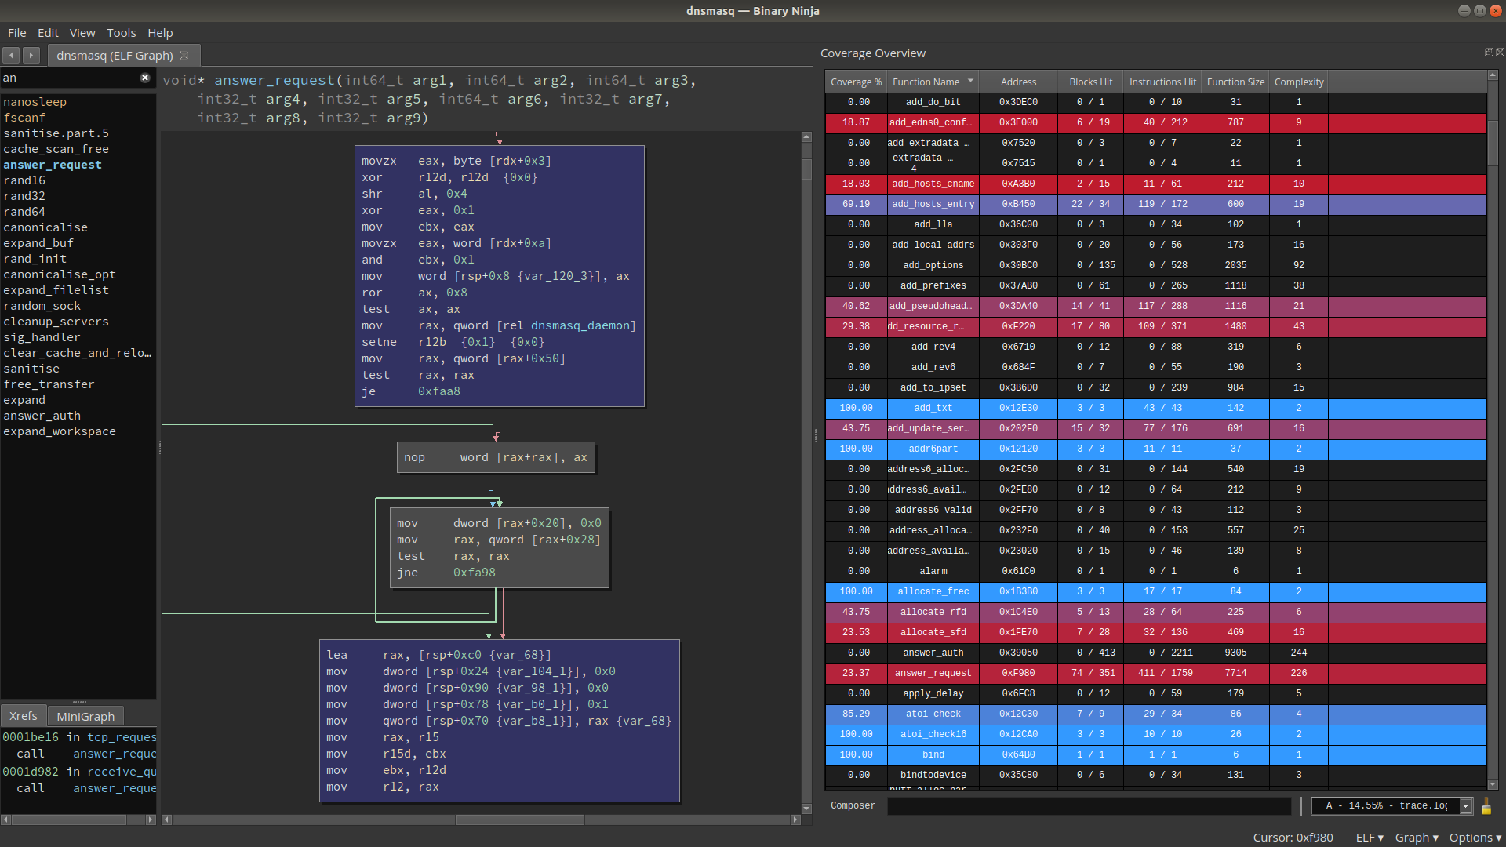

Slide 33
Target specific fuzzer
Does it support the entire protocol?
All record types
Dns cookies
Multi-question queries
Zone transfers (axfr)

Slide 34
Target specific fuzzer
Is there more to the attack surface?
Structured Exception Handling (SEH)
Additional commands
Other protocols

Slide 35
Target specific fuzzer
Rfc adherence
Does it do what it’s supposed to
If not, this is where the fun starts

Slide 36
Fuzzing Rate
Don’t bury your target with inputs
If it can only handle 100 inputs a second, don’t send 1,000 inputs a second
Will lead to issues with crash replay
Fuzzer thinks it crashed it on seed 40,000, when it crashed it on seed 20,000

Slide 37
Will my fuzzer exhaust all possible inputs?

Slide 38
Inputs Per Day
10 inputs per second
600 inputs per minute
36000 inputs per hour
864000 inputs per day

Slide 39
Combinations
Header: ID - 0xffff (65535)
Header: Flags - 160
Header: Qdcount -0xffff (65535)

Slide 40
Combinations
Header: Ancount - 0xffff (65535)
Header: Nscount - 0xffff (65535)
Header: Arcount - 0xffff (65535)

Slide 41
Combinations
Question: QName - 5100 (len 20)
Question: QType - 0xffff (65535)
Question: QClass - 0xffff (65535)

Slide 42
Combinations
65535 * 160 * 65535 * 65535 * 65535 * 65535 * 5100 * 65535 * 65535
=
42365263502777049134903*10^16

Slide 43
Not Going to Happen
How long at that rate?
1.34 * 10^31
What if we sent 1,000,000 a second?
1.35 * 10^25

Slide 44
Lowball Figure
Didn’t include corrupters
Didn’t include zone transfers (axfr)
Didn’t include dns cookies
Actual number is a lot higher

Slide 45
Demo Time!

Slide 46
Debugging a Crash
Target DNSMasq 2.77
https://security.googleblog.com/2017/10/behind-masq-yet-more-dns-and-dhcp.html
I’m going to be using binja/gdb-gef
https://github.com/hugsy/gef
https://binary.ninja/

Slide 47
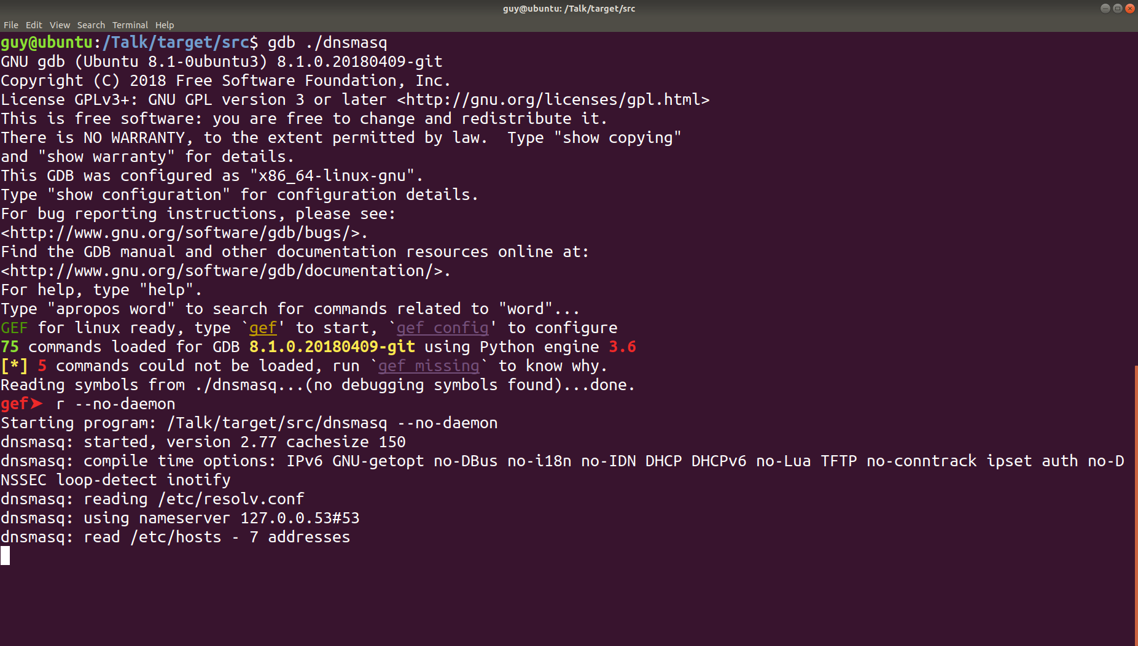

Slide 48
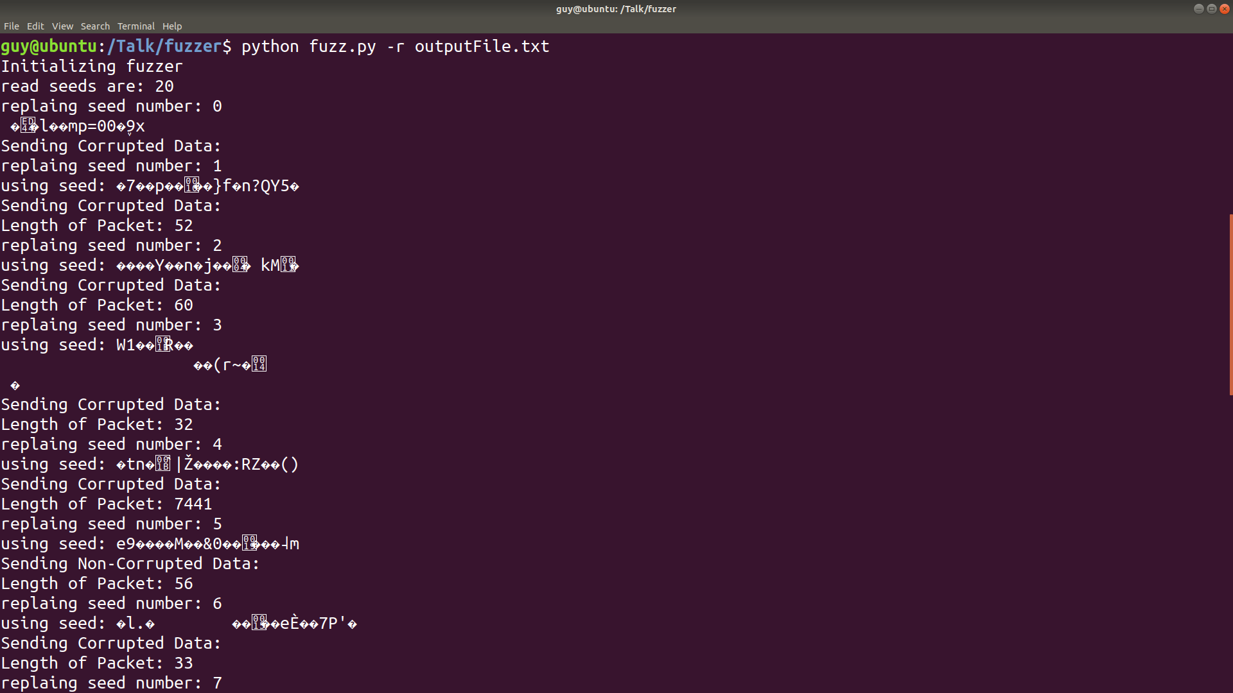

Slide 49
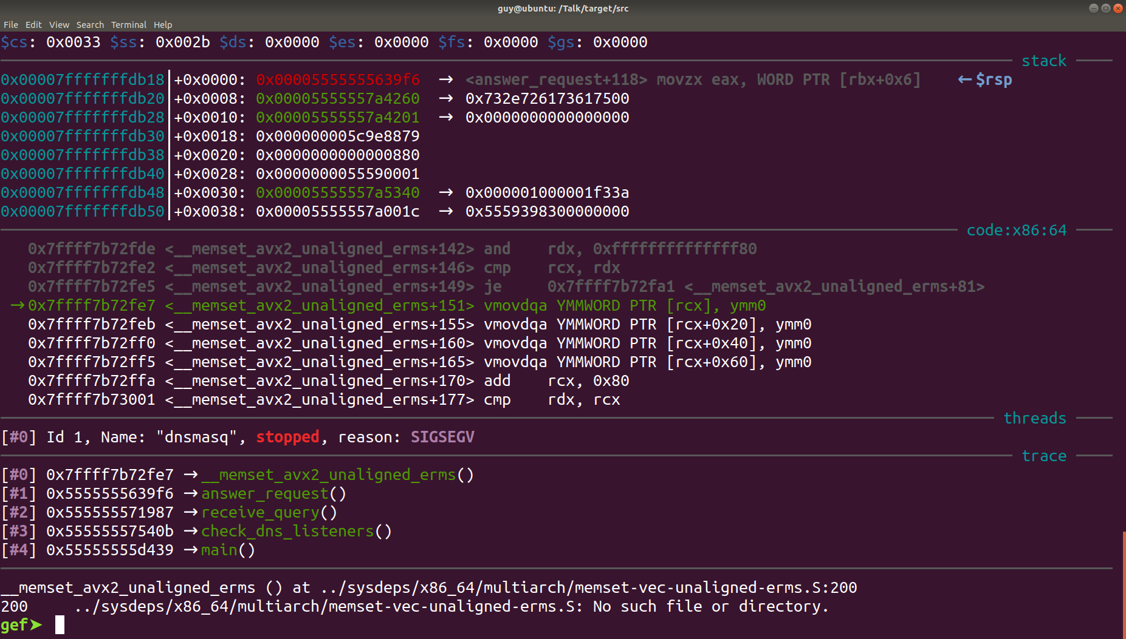

Slide 50
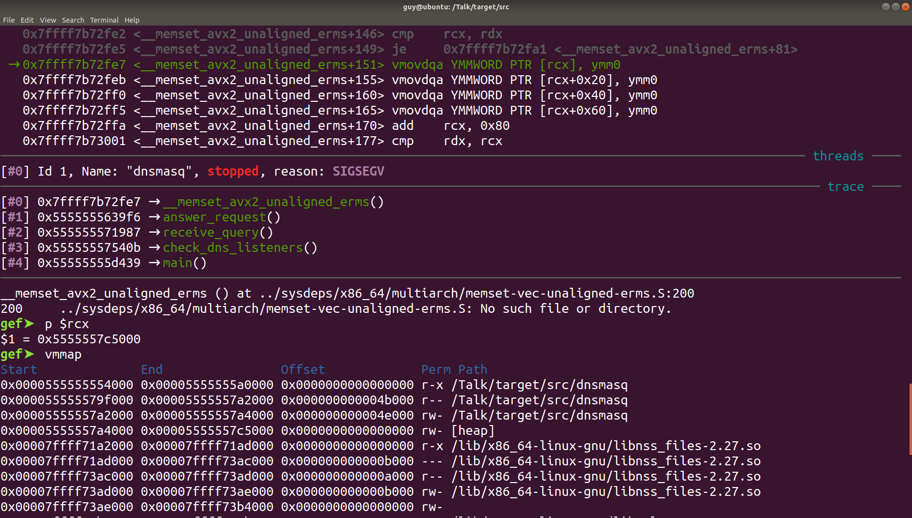

Slide 51
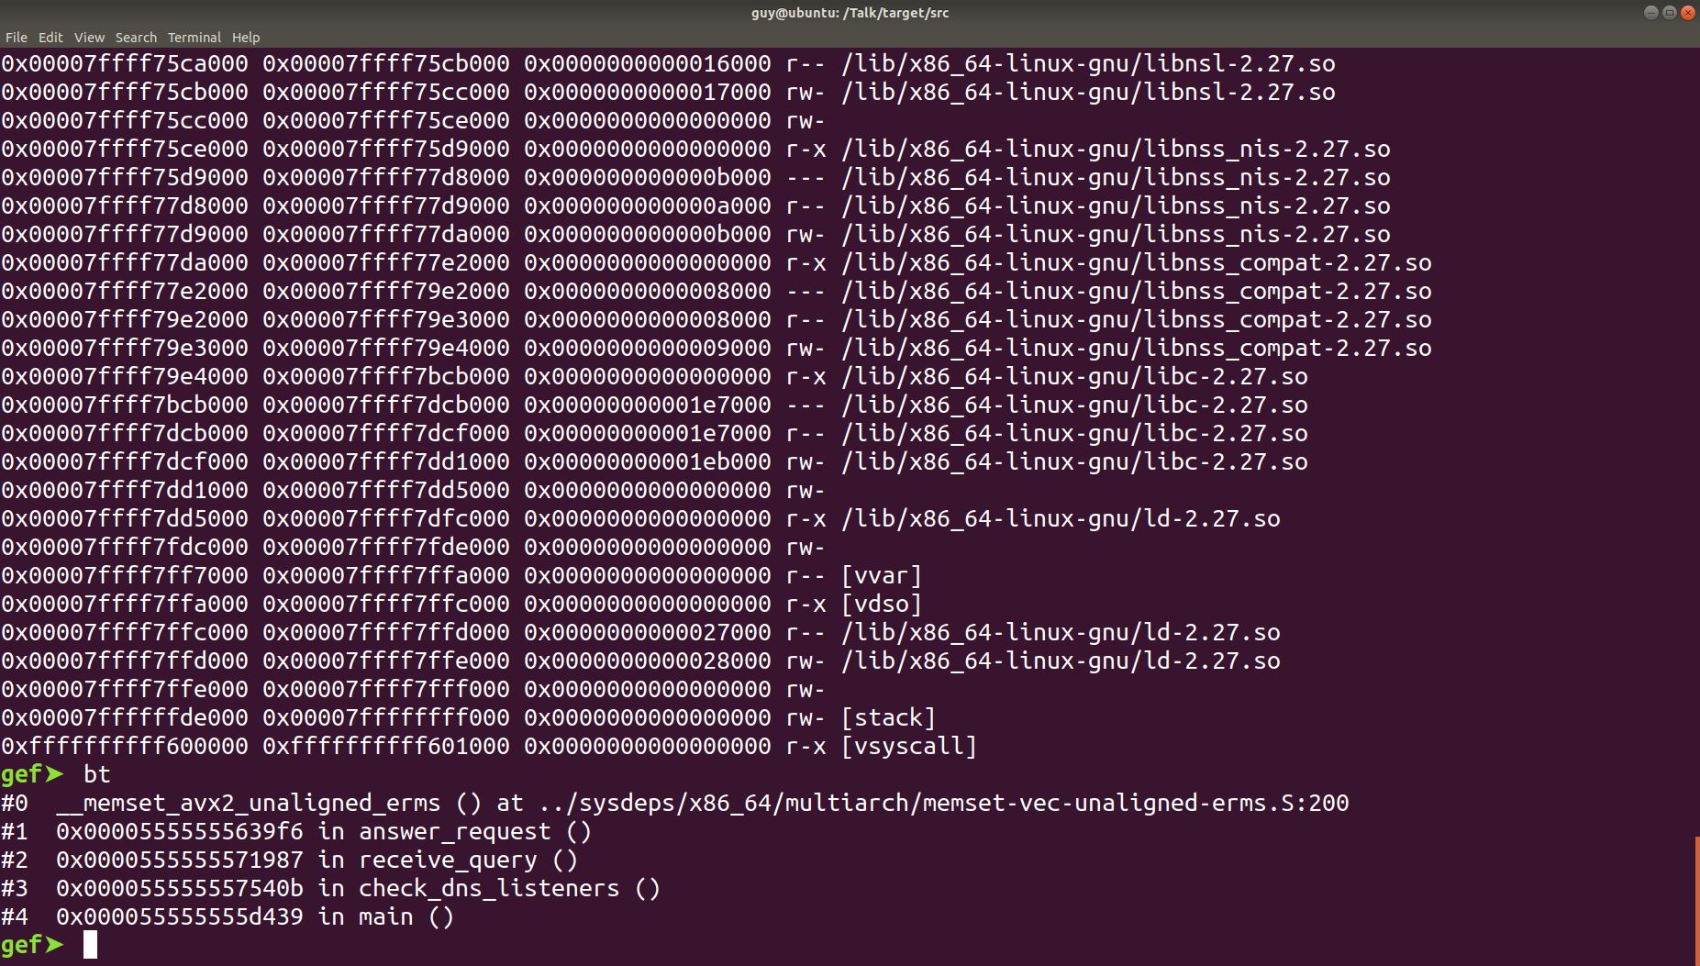

Slide 52
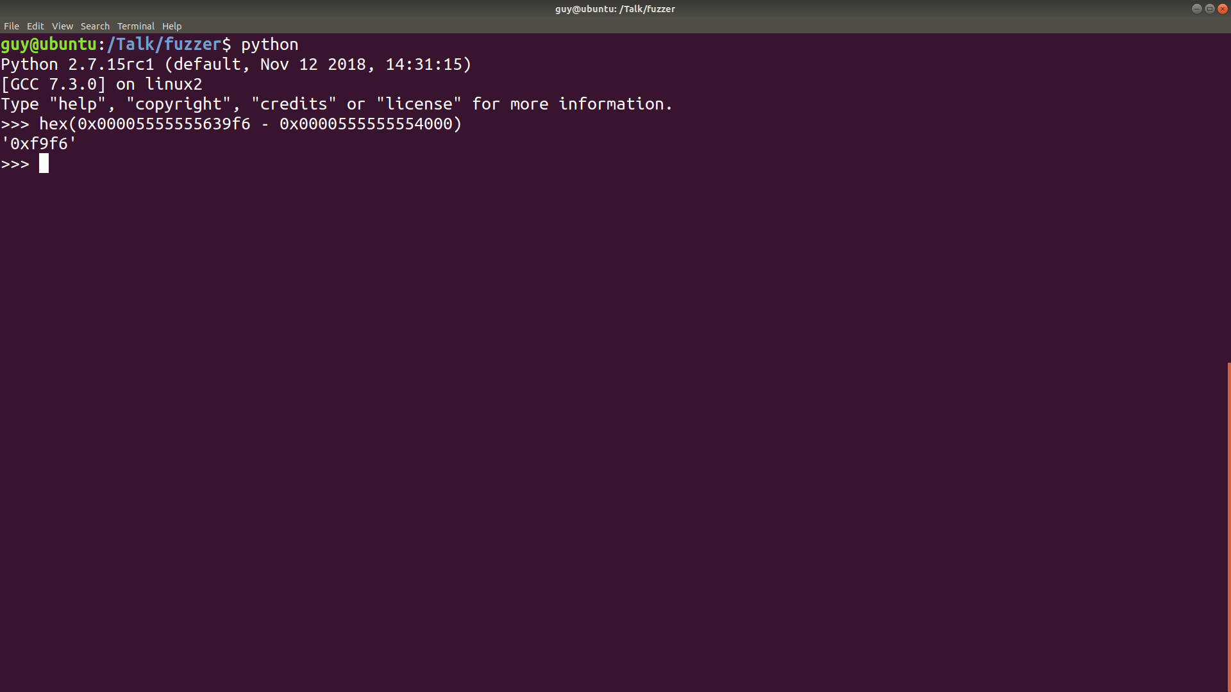

Slide 53
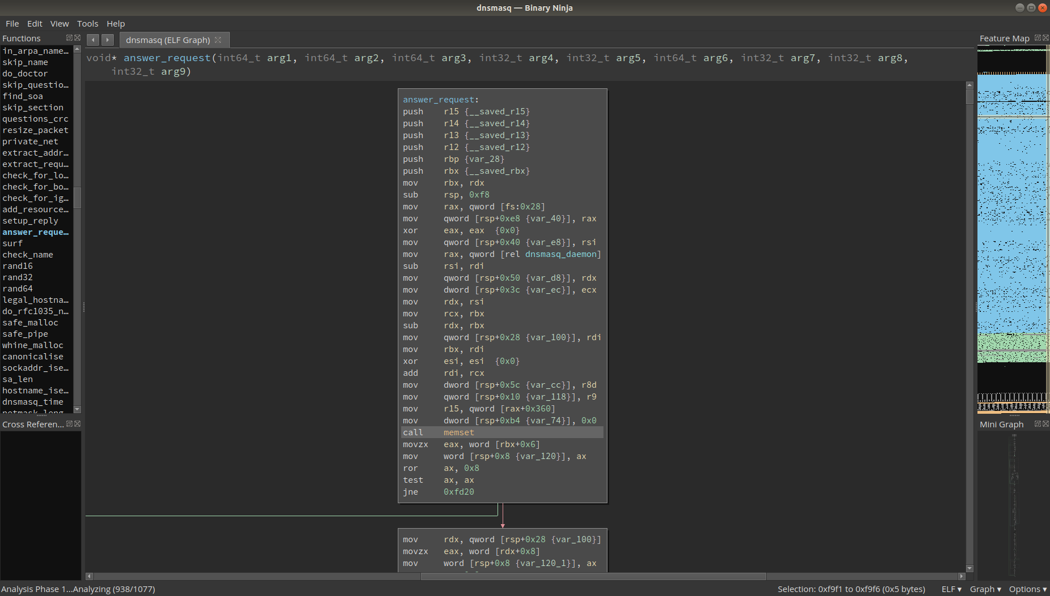

Slide 54
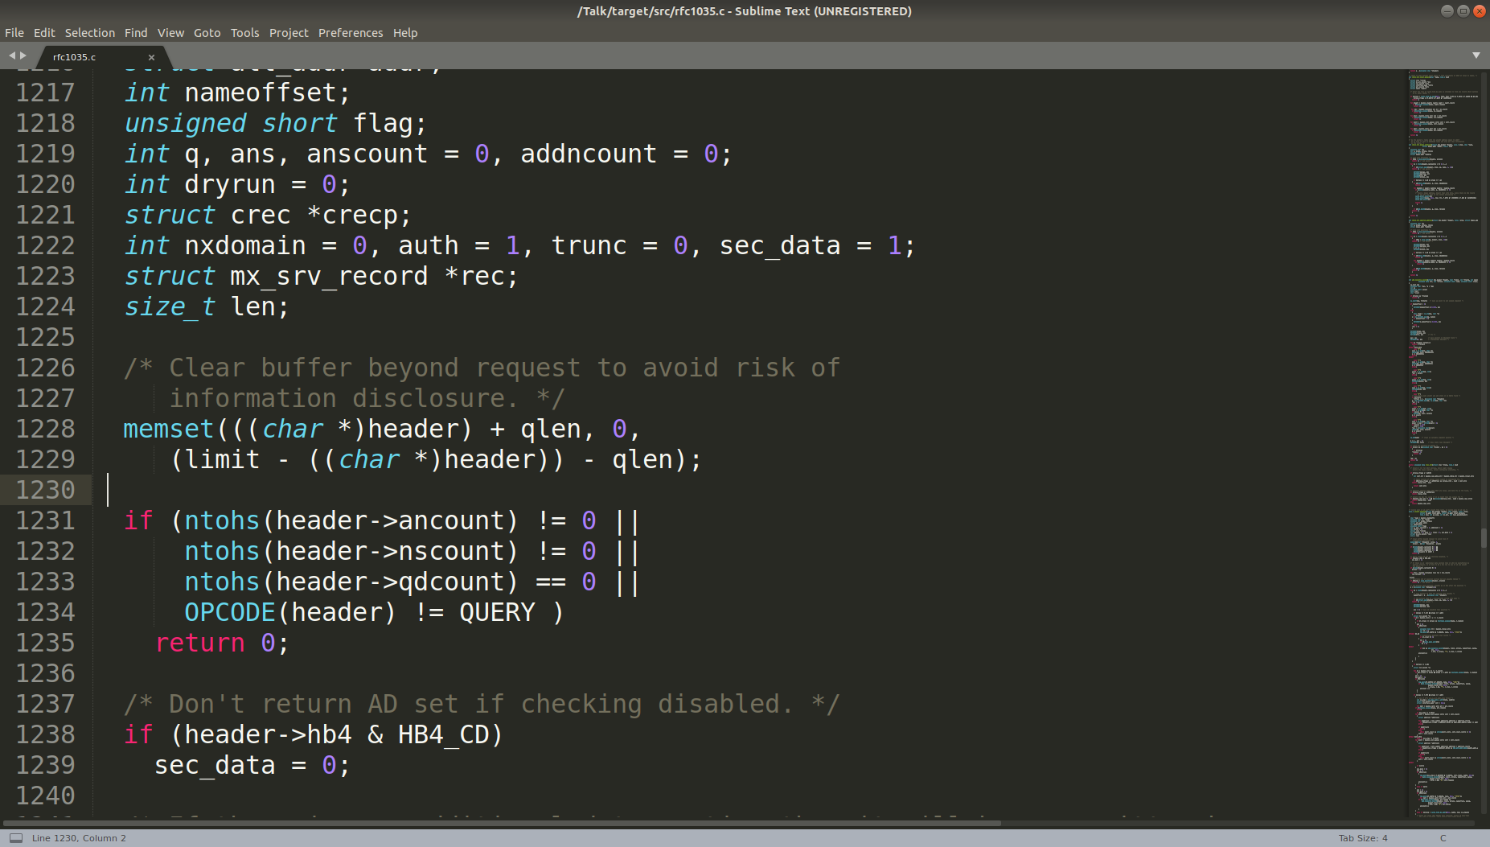

Slide 55
Questions?

Slide 56
Try it Out
Try fuzzing DNSMasq 2.77
CTF challenge specifically made to go with this talk
Write your own fuzzer

Slide 57
Special Thanks
Scott Devault \ Jonathan Grimm
Got me interested in infosec
Hack@ucf
Helped me take my first couple of steps in infosec
Raytheon SI (Center of Innovation)
Teaching me most of the stuff I said here

Slide 58
Projects
DNS Fuzzer
https://github.com/guyinatuxedo/dns-fuzzer
Other projects
Ctf writeups
Emulator / debugger
https://github.com/guyinatuxedo

Slide 59
Who is This Guy?
College Student
Worked at Raytheon SI, and a couple other places
Used to do CCDC, now just CTFs
Spends most of my time staring at assembly
Twitter: @aguyinatux
Just a guy, who’s not in a tuxedo

